Slide 1
High School Alcoholism and Academic Performance
BDA 2025 GrosseDaten

Slide 2
Selection for the Survey
https://forms.gle/CUUYaQfBL8tca3nx7
Tourism Employment | – Metrics to boost tourism and hospitality revenue – Unlocking tourism’s economic power
LinkedIn Positions | – Real-time labor market demands – Trends in high-demand skills and industries – A workforce aligned with tomorrow’s jobs – Mastering labor market shifts
Agricultural CO₂ Emission | – Climate thresholds threatening food security – A planet stabilized from emissions collapse – Halting environmental degradation
Student Performance | – Optimizing academic success through lifestyle choices – Nurturing student potential – Education systems failing to adapt to student needs

Slide 3
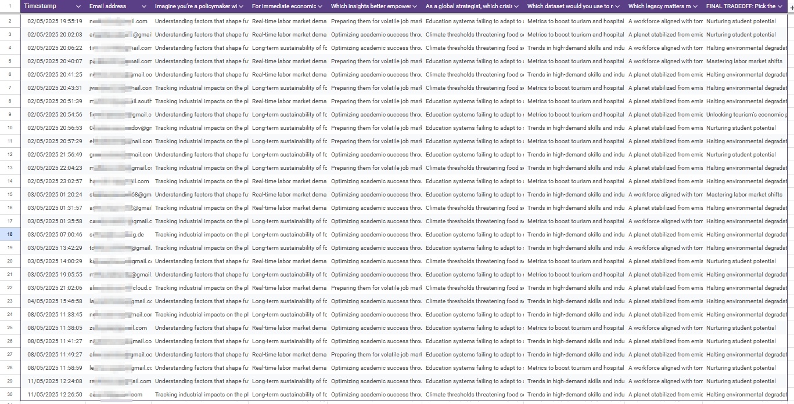
Survey

Slide 4
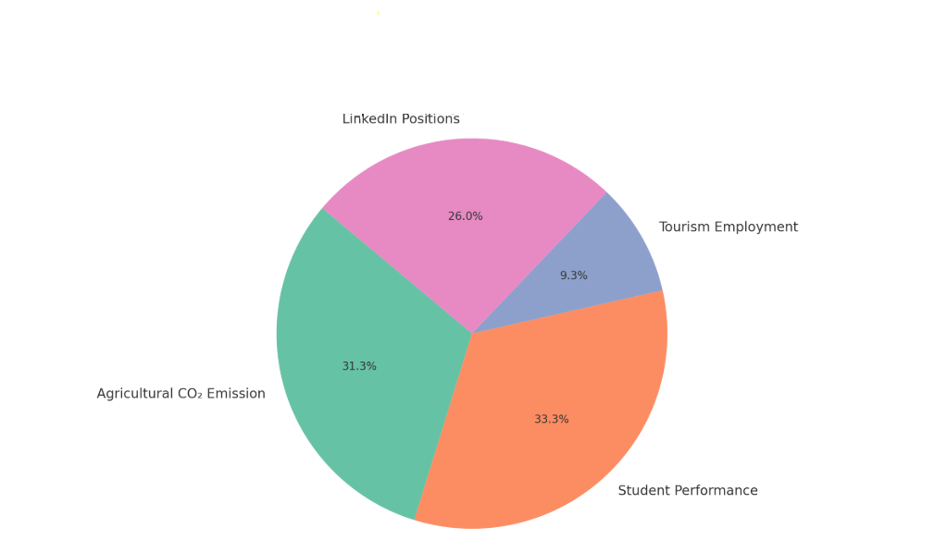
Evaluation

Slide 5
Use case
Dataset slide
Data source slide
Providing advice for high school students through data insights
https://www.kaggle.com/datasets/gabrielluizone/high-school-alcoholism-and-academic-performance
The data was gathered by P. Cortez and A. Silva for the study “Using Data Mining to Predict High School Student Performance,” presented at the 5th Future Business Technology Conference (FUBUTEC, 2008) in Porto, Portugal.

Slide 6
Features in dataset
school
sex
age
address
famsize
Pstatus
Medu
Fedu
Mjob
Fjob
reason
guardian
traveltime
studytime
schoolsup
famsup
paid
activities
nursery
higher
internet
romantic
famrel
freetime
goout
Dalc
Walc
health
absences
G1
G2

Slide 7
Tools and AI methods
We will explore machine learning techniques such as SVM, clustering, linear regression, and deep learning.
Examples:
Predict Final Grades: Regression
Classify Academic Risk: SVM
Cluster Student Profiles: Clustering
Explore Feature Relationships: Correlation
Using Python in Jupyter Notebooks, integrated with GitHub—and adapt our approach based on ChatGPT’s suggestions.

Slide 8
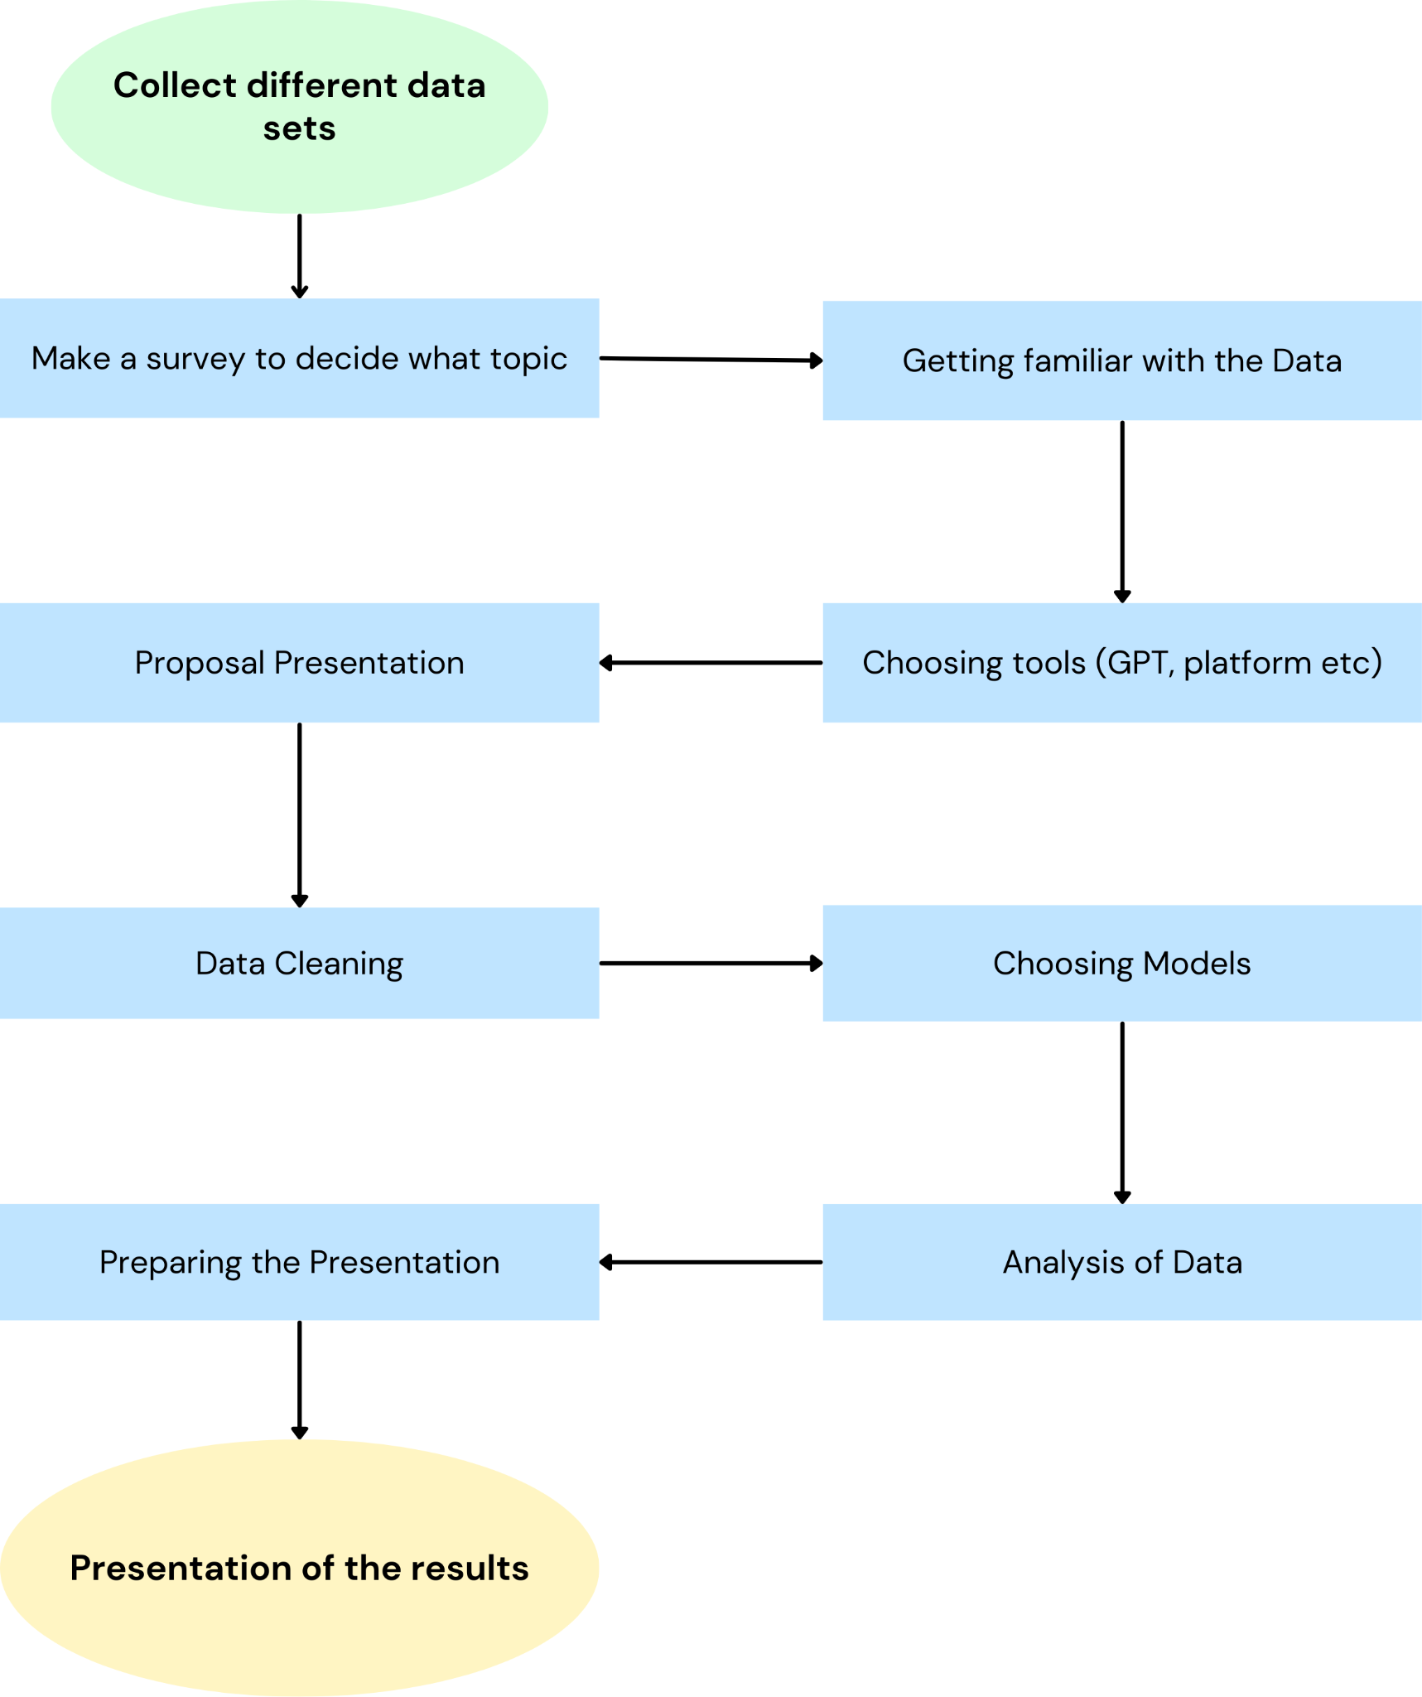
Action Plan
 | Specifics | Who
Collecting Datasets | 3-5 datasets to choose from | Leonie
Making Survey | questions to determine interest | Gabriel and Genta
Choosing tools | Discussion for collaboration | All
Proposal Presentation | Prepare and present | All
Data Cleaning | Handling duplicates, missing values, etc. | Linda
Choosing Models | relevant metrics | All
Analysis of data | get different insights | All
Presentation Preparation | visualizations | All

